Slide 1
Introduction to SUSE Studio
Tim Serong <tserong@novell.com>
Senior Clustering Engineer
OPS Engineering, Novell Inc.

Slide 2
SUSE Studio is...
A web app for building custom Linux distros
Build Live CDs, VM images, EC2 images, disk images
Freely usable at susestudio.com by anybody
Notes:
Easy to use
Distro a bit of a misnomer, in that they're all SUSE based :)
EC2 is interesting – you can upload straight to Amazon from Studio (may be a beta thing right now)
Mention appliance terminology

Slide 3
Notable Features Include...
Configure everything once (users, network, etc.)
Upload custom files, scripts, applications
Test Drive “appliance” directly in your web browser
  Save modifications back to your appliance
Notes:
Timezone, firstboot, installed packages, branding
OBS
Storage – appliance may be deleted (but can be rebuilt)

Slide 4
You Might Care if...
You want repeatable VM deployments
You want to make demo CDs
You're an ISV
You've been given a SUSE appliance thing by an ISV
Notes:
I've used it for VMs for HA testing
Likewise for demo CDs for HA stuff
ISV building software appliance, IHV (“perfect myth box?”)
Rumour has it some ISVs build “non-upgradeable” appliances, something to watch out for.

Slide 5
I Should Probably Also Mention...
SUSE Studio Onsite is available for purchase
  Use it inside your firewall
SUSE Studio is actually a frontend for KIWI
  http://en.opensuse.org/Portal:KIWI
There's also susegallery.com, for sharing appliances
Notes:
Part of SUSE Appliance Toolkit
WebYaST, SLMS
Export/import KIWI
Get other appliances (LAMP, etc.)

Slide 6
Time for a Walkthrough

Slide 7
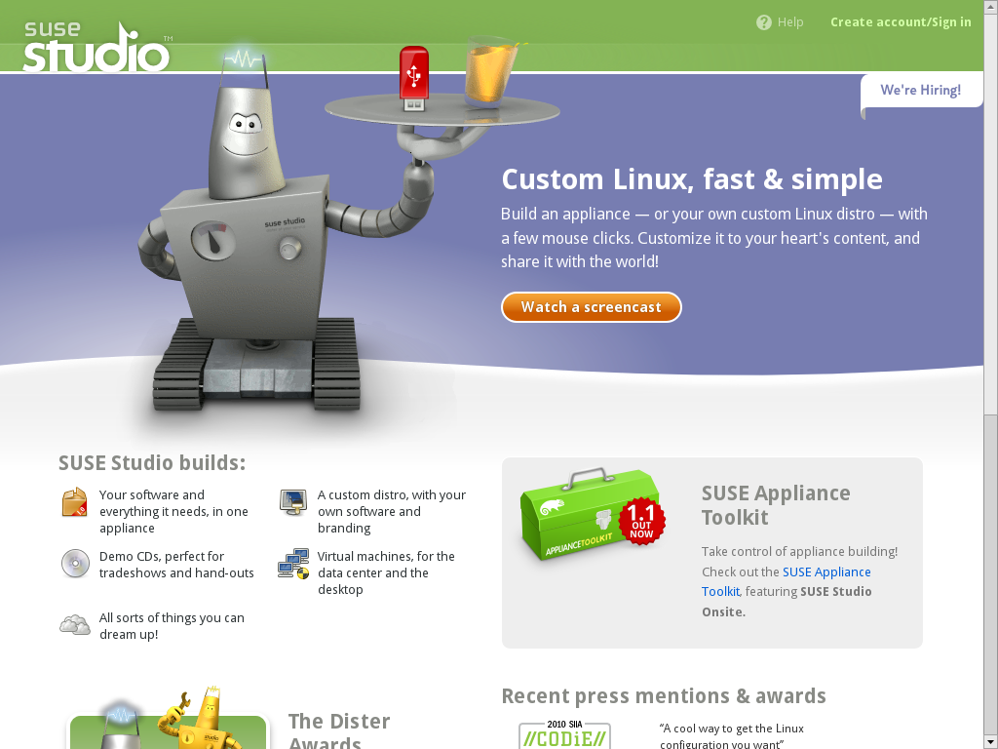

Slide 8
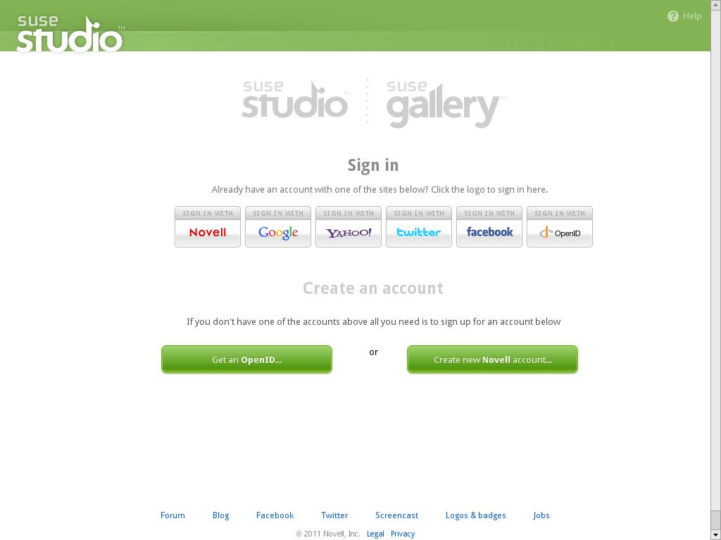

Slide 9
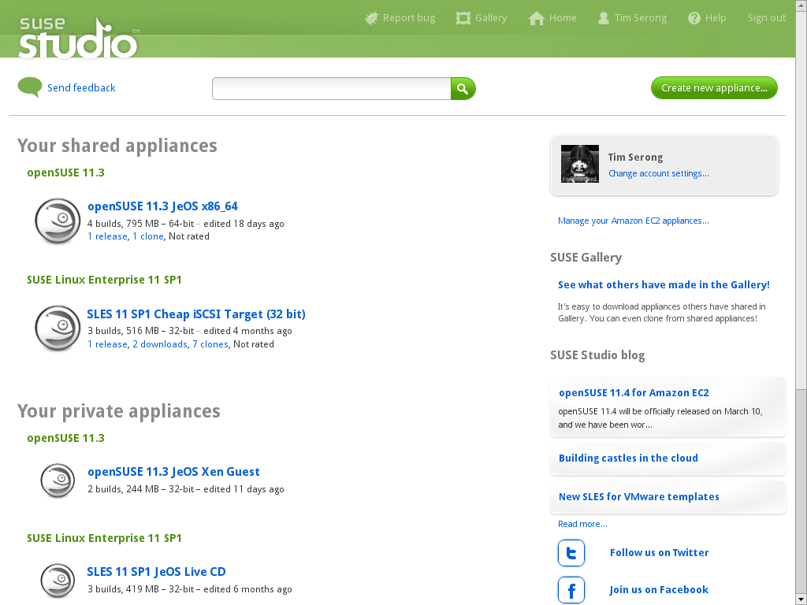

Slide 10
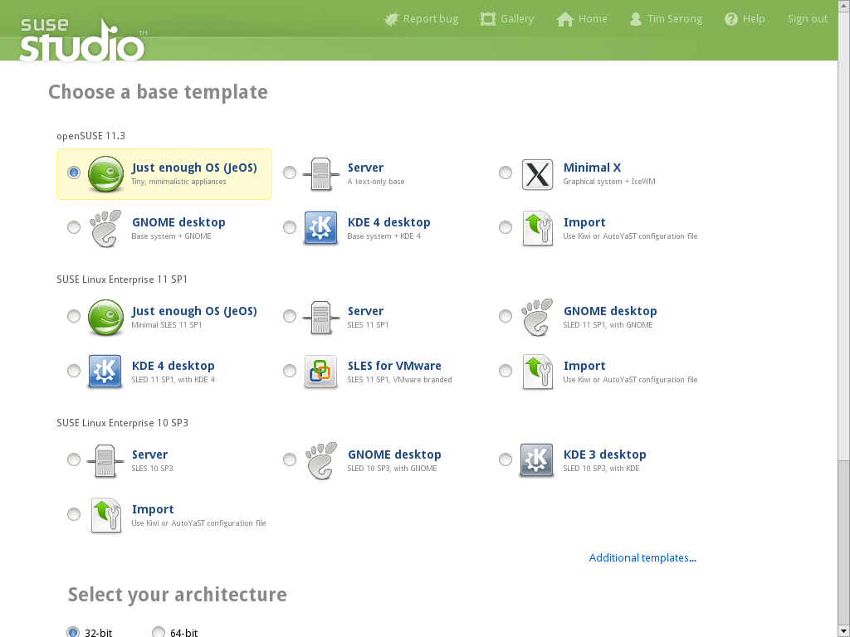

Slide 11
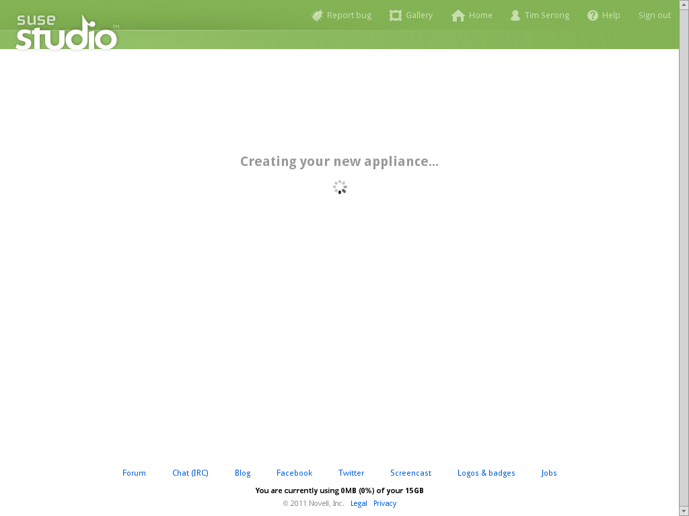

Slide 12
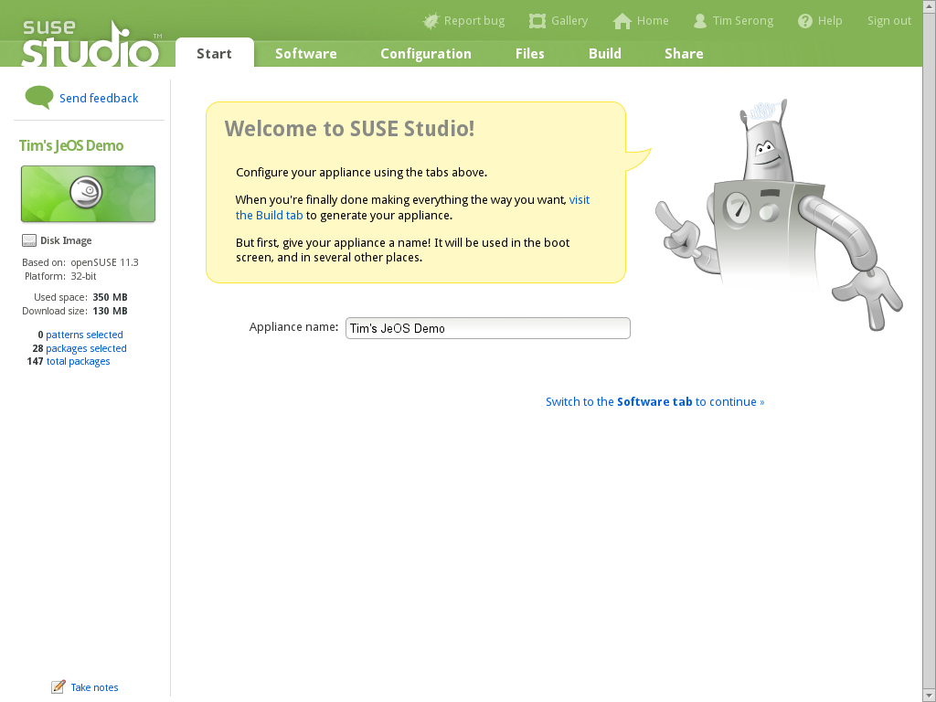

Slide 13
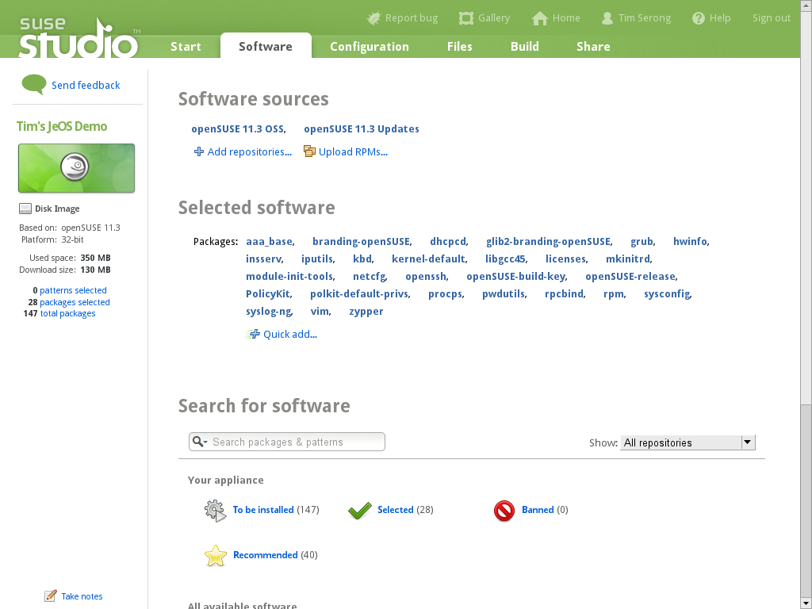
Notes:
Update repos / zypper

Slide 14
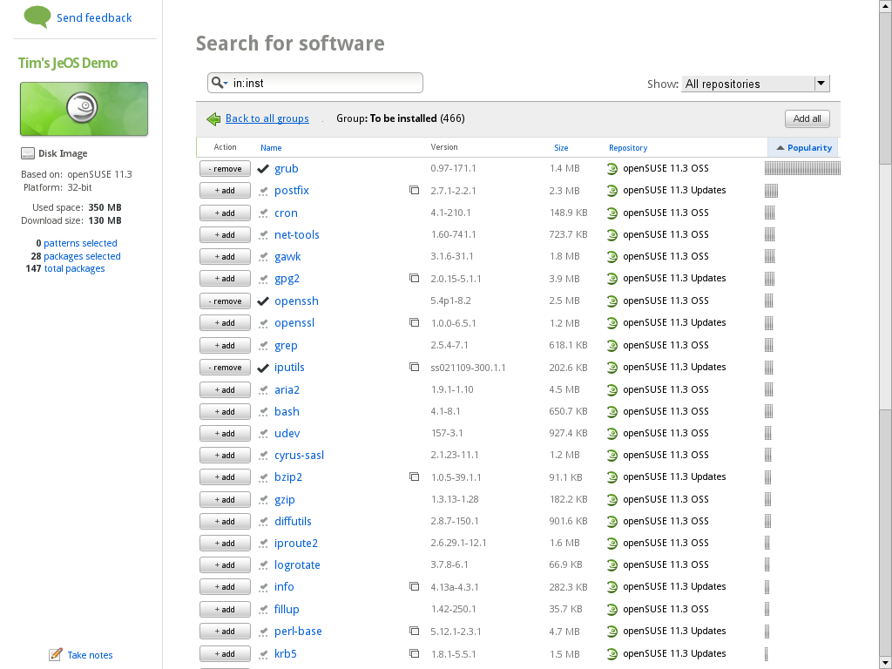

Slide 15
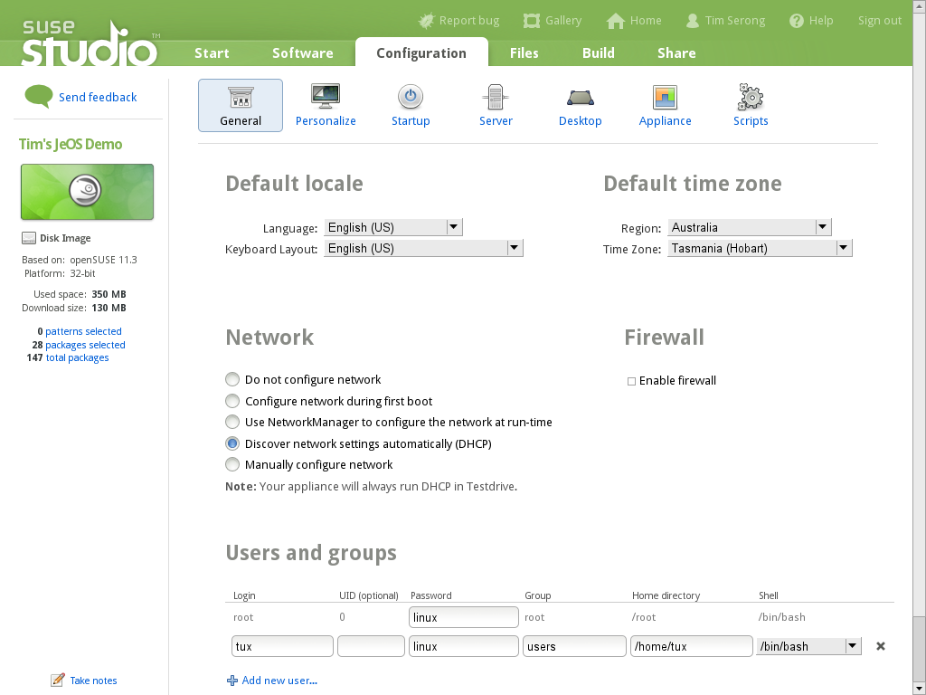

Slide 16
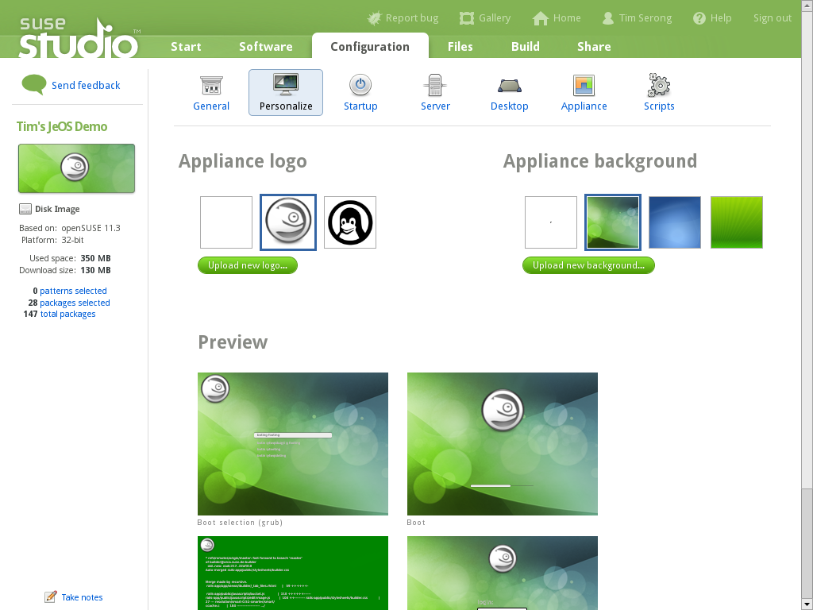

Slide 17
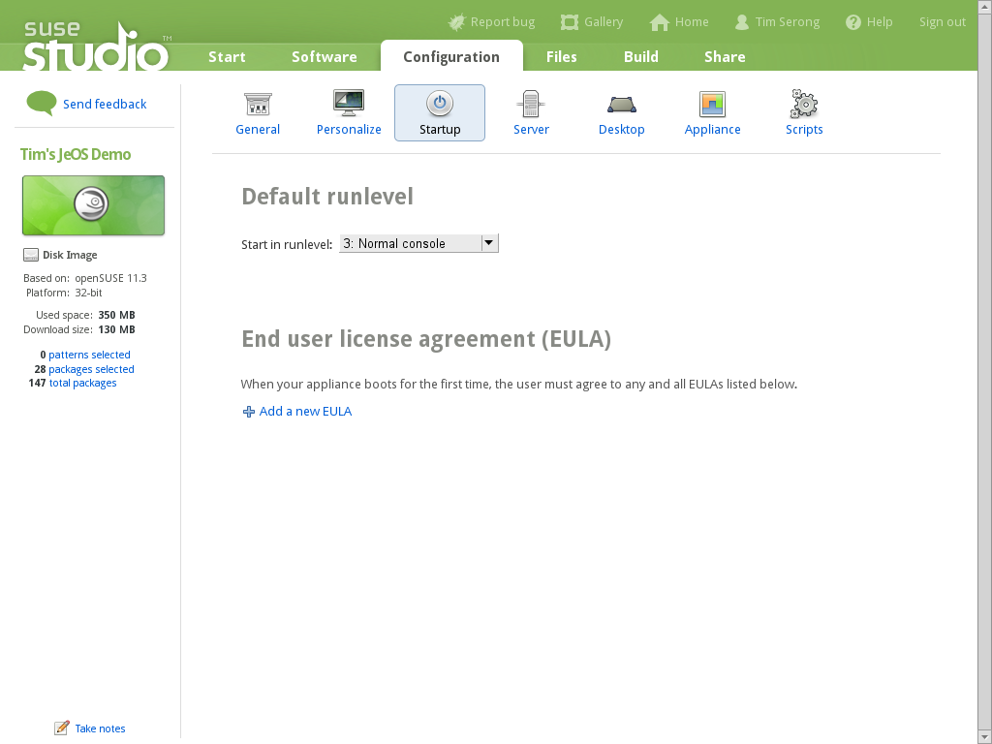

Slide 18
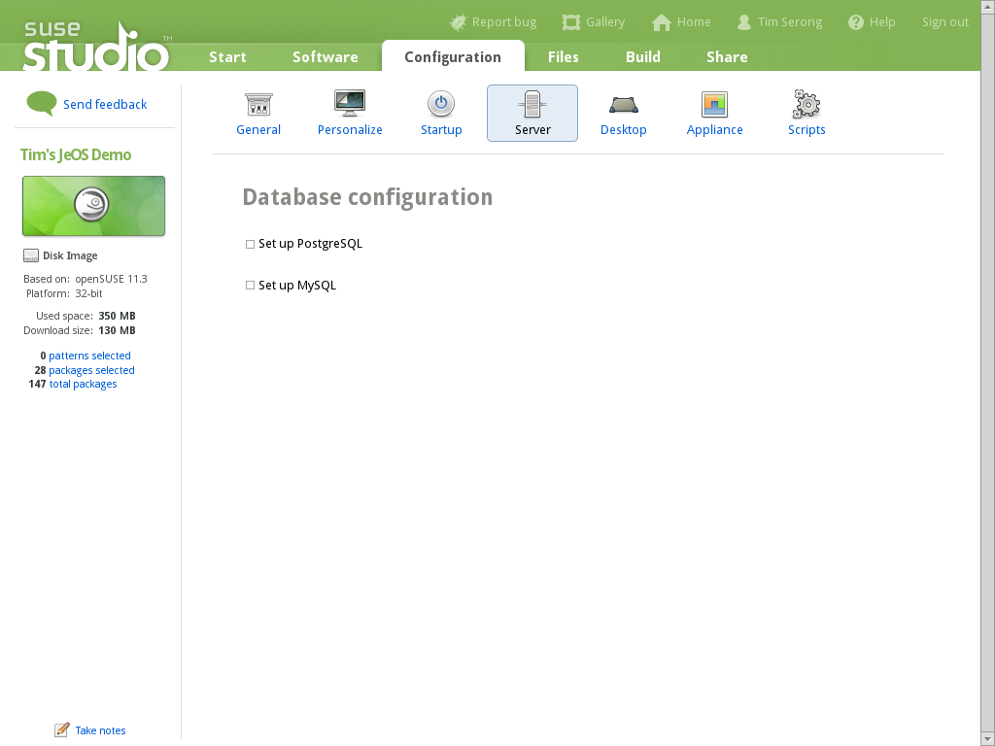

Slide 19


Slide 20
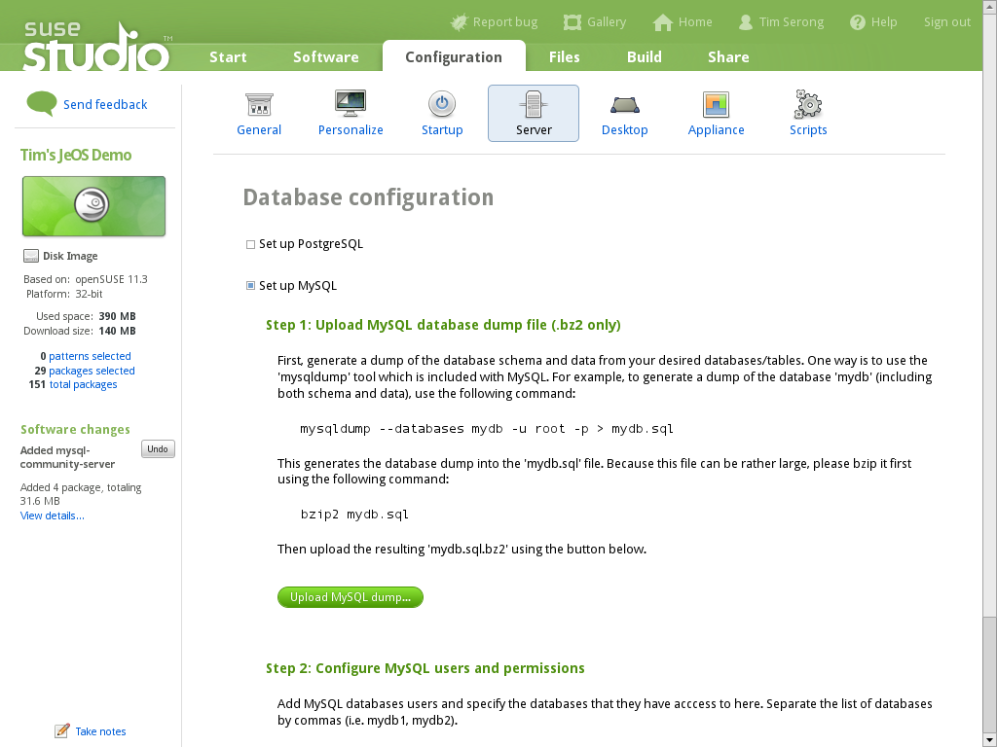

Slide 21
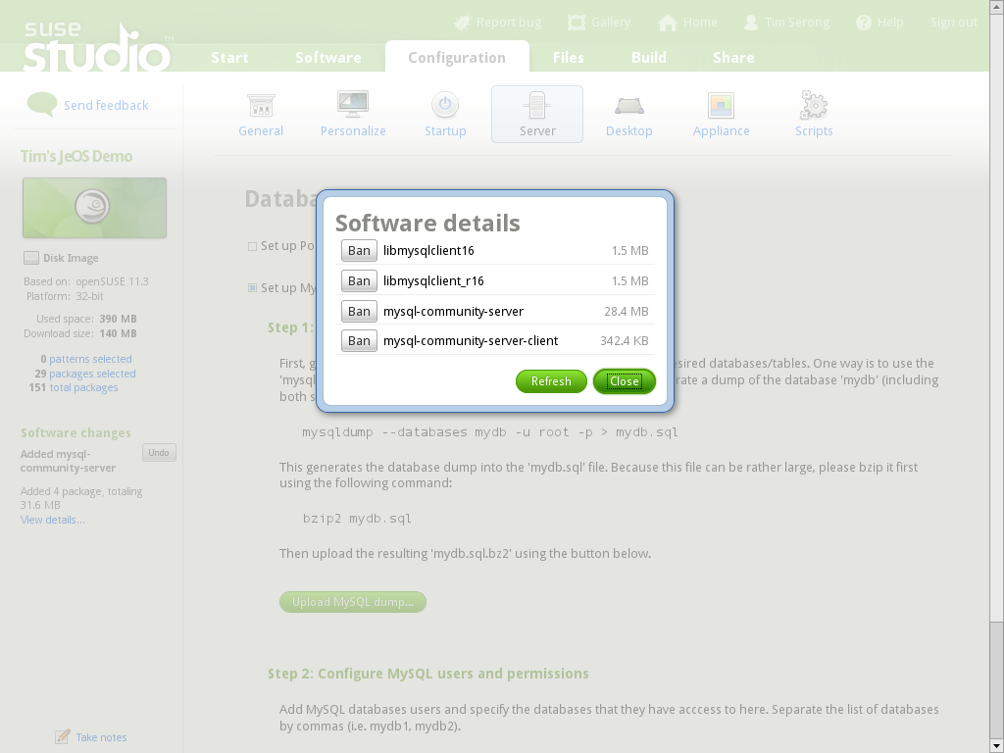

Slide 22
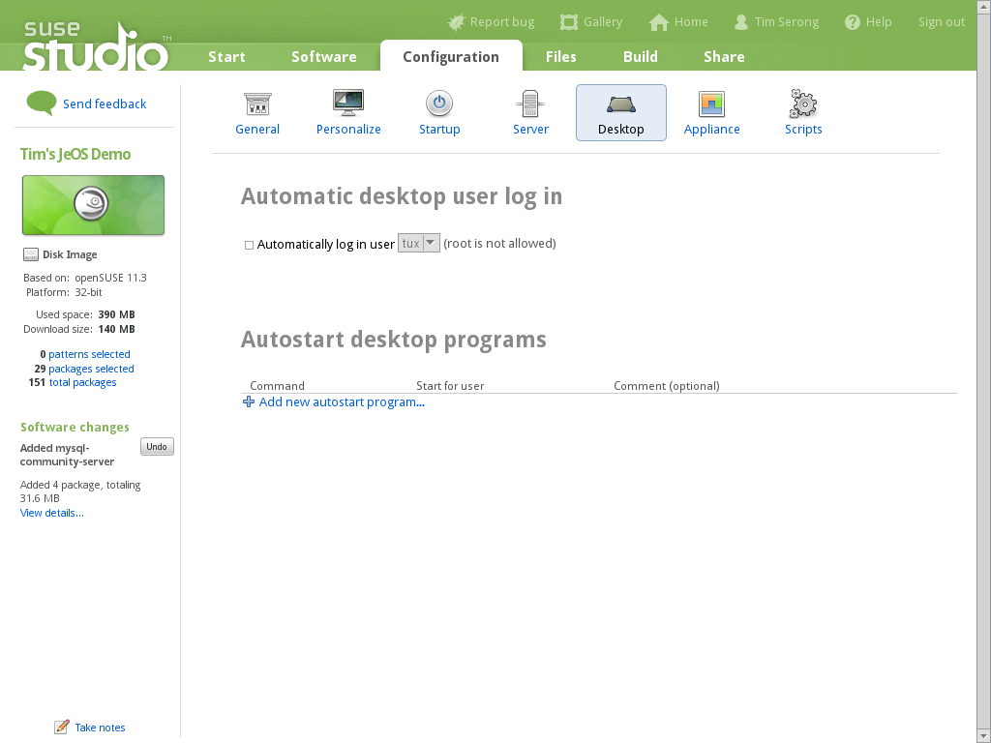

Slide 23


Slide 24
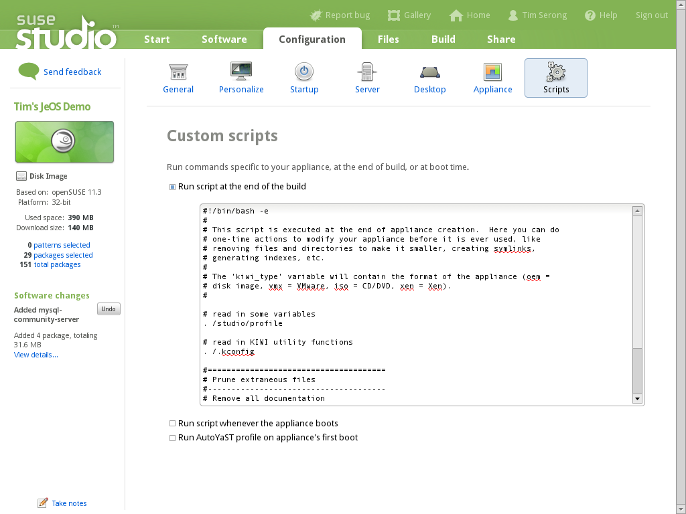

Slide 25
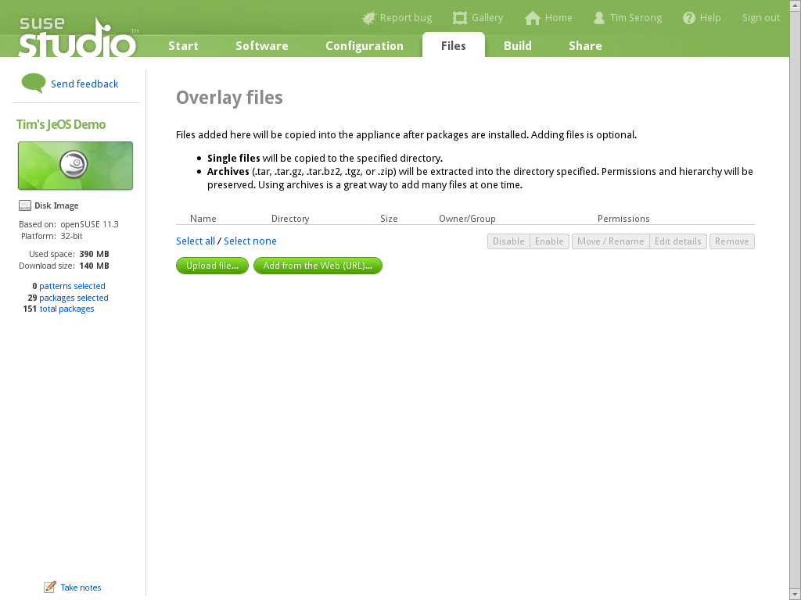

Slide 26
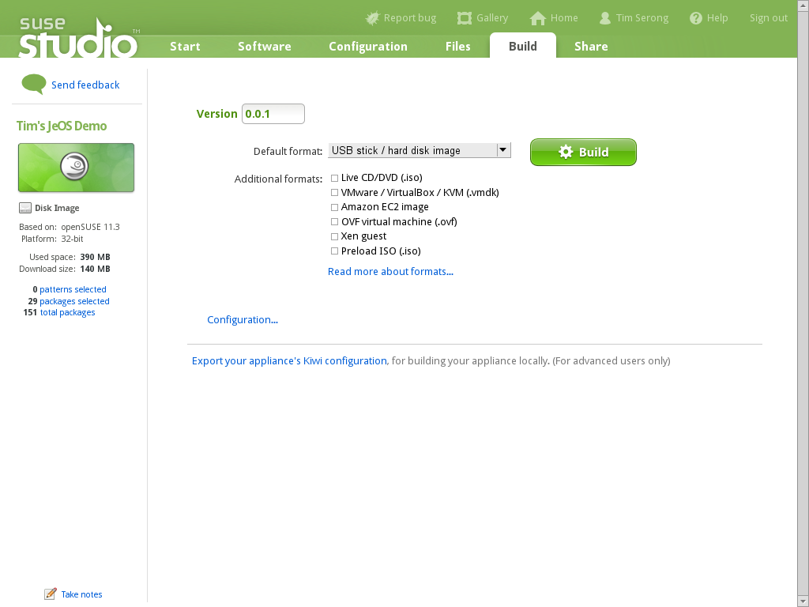

Slide 27


Slide 28


Slide 29


Slide 30
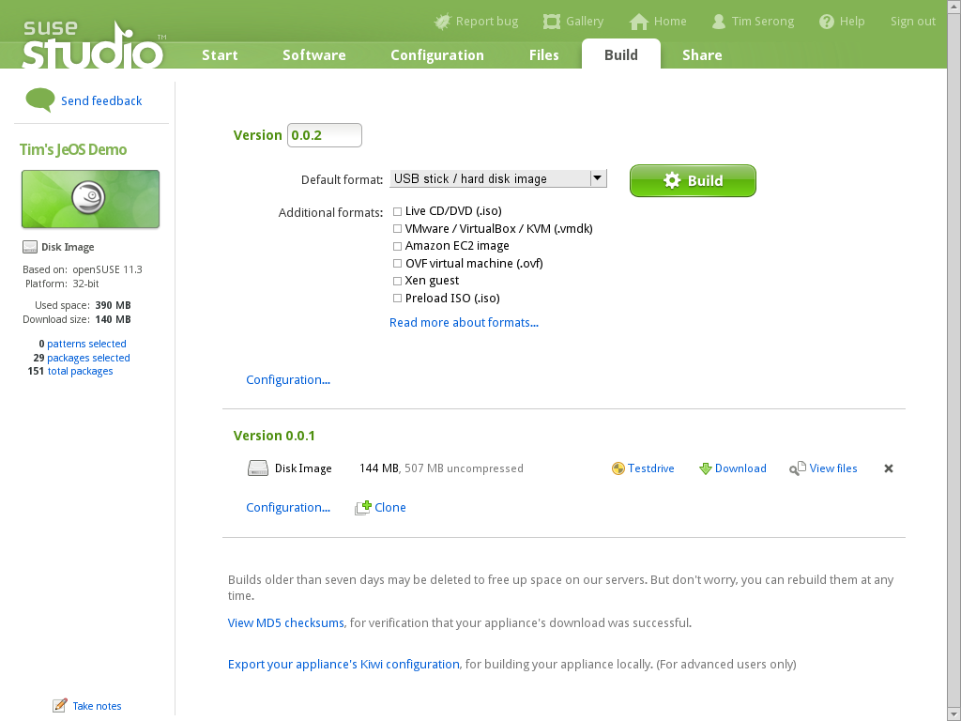

Slide 31
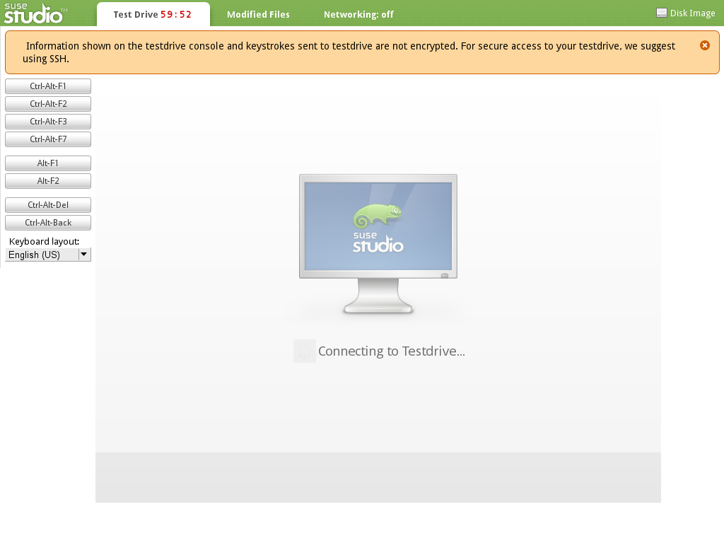

Slide 32
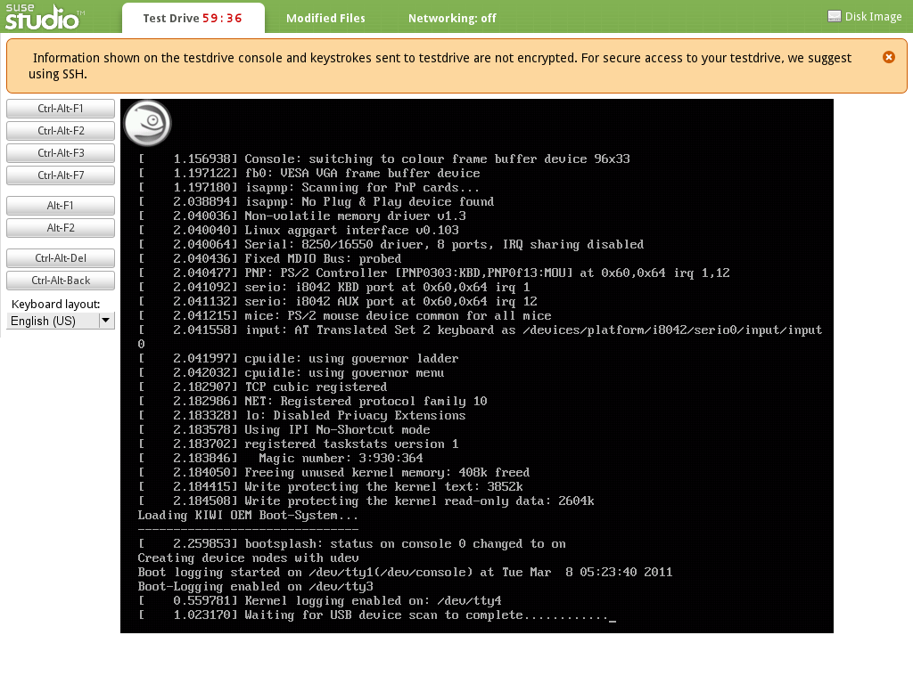

Slide 33
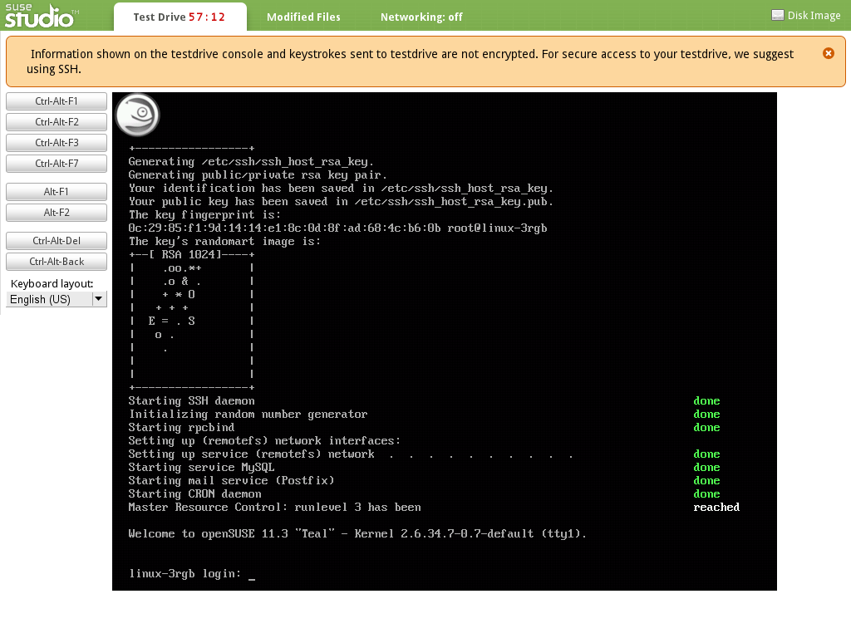

Slide 34
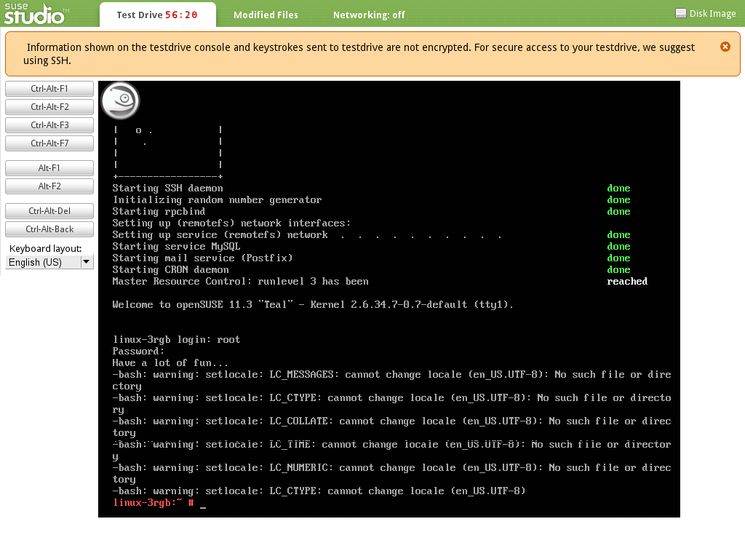
Notes:
Note locale errors

Slide 35
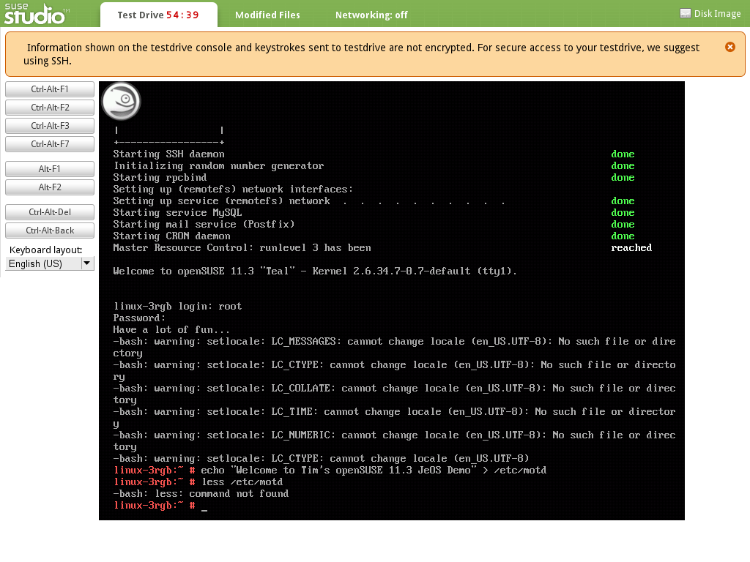
Notes:
Edited file
Note “less” is not installed

Slide 36
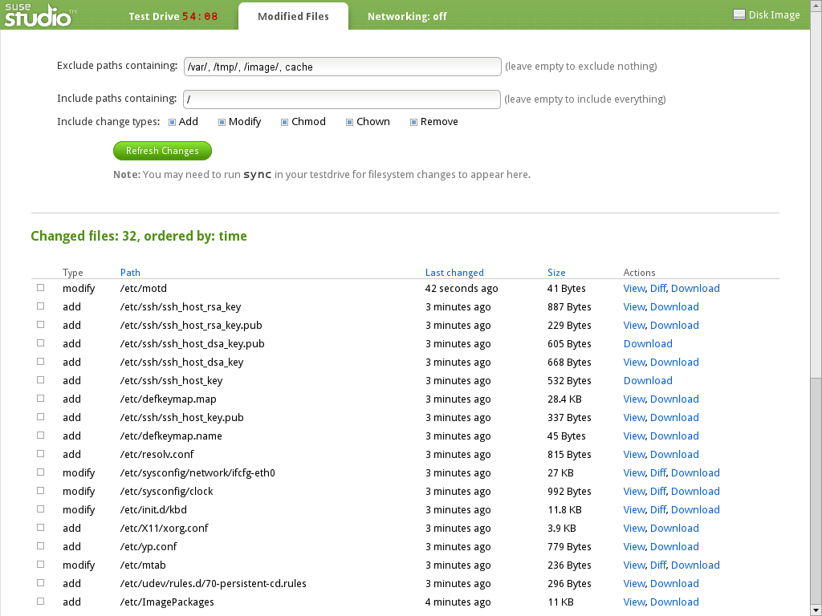

Slide 37
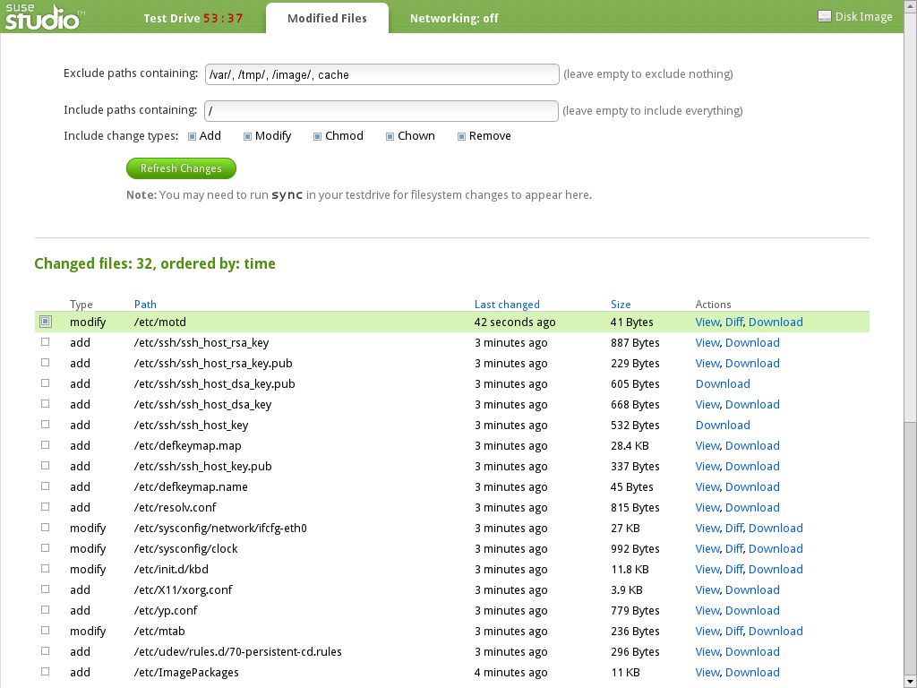

Slide 38
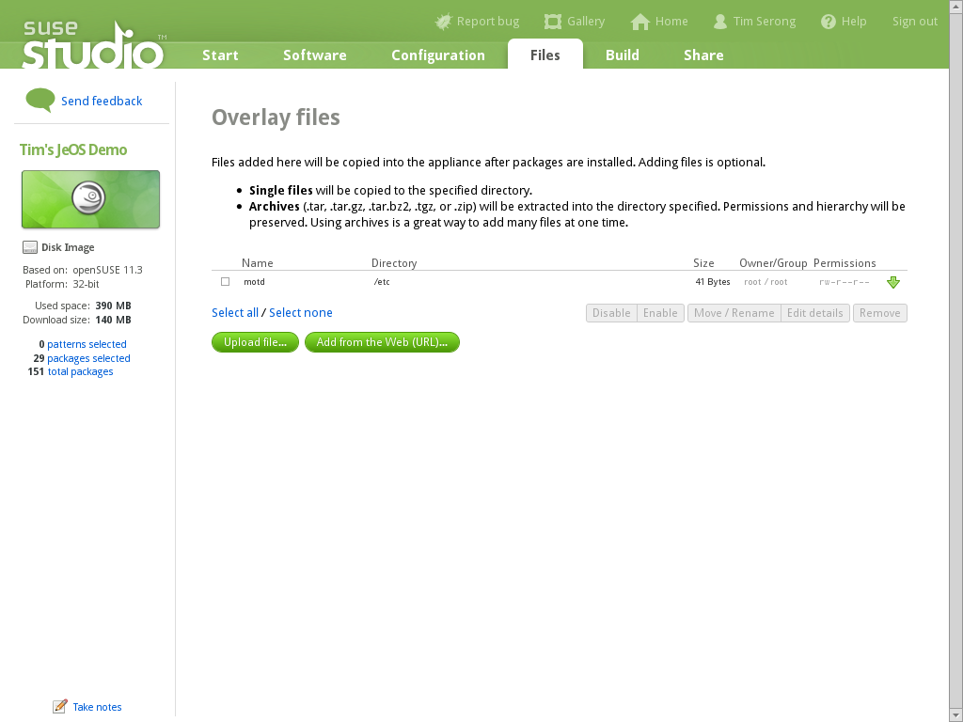

Slide 39
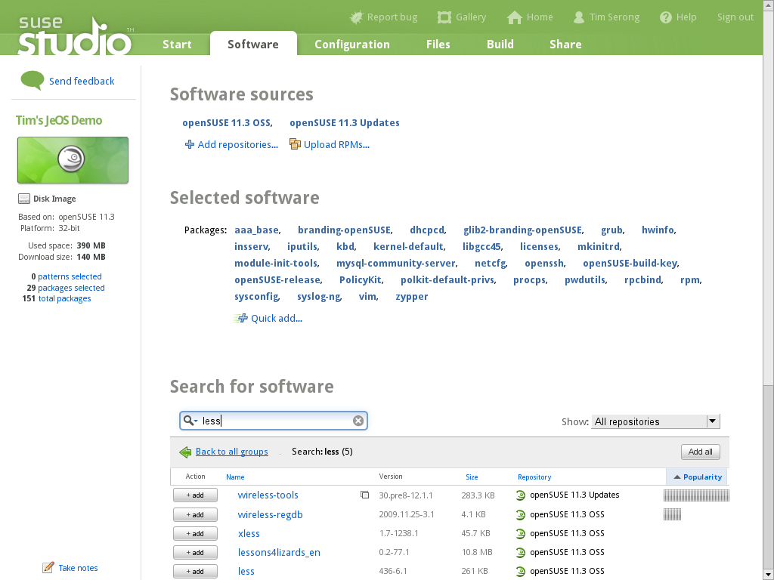

Slide 40
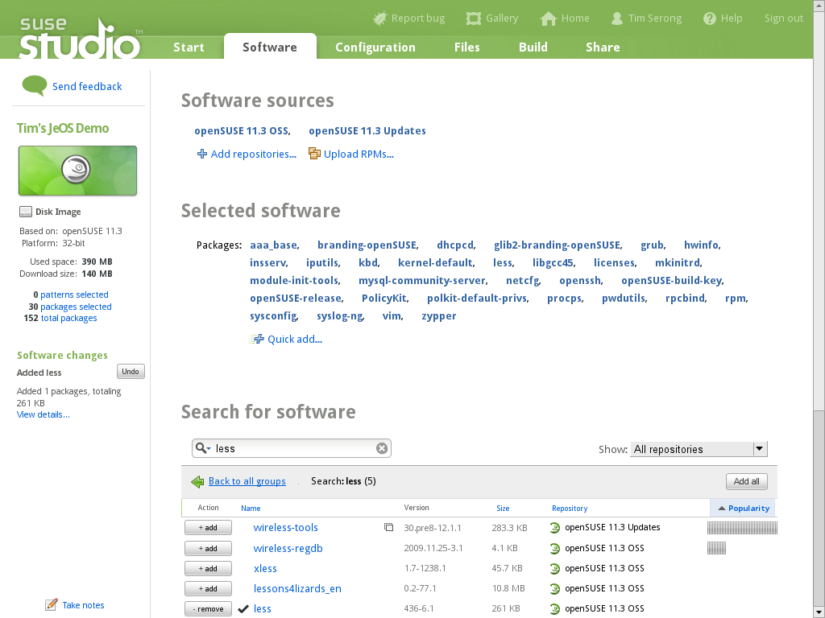
Notes:
Find “less”

Slide 41
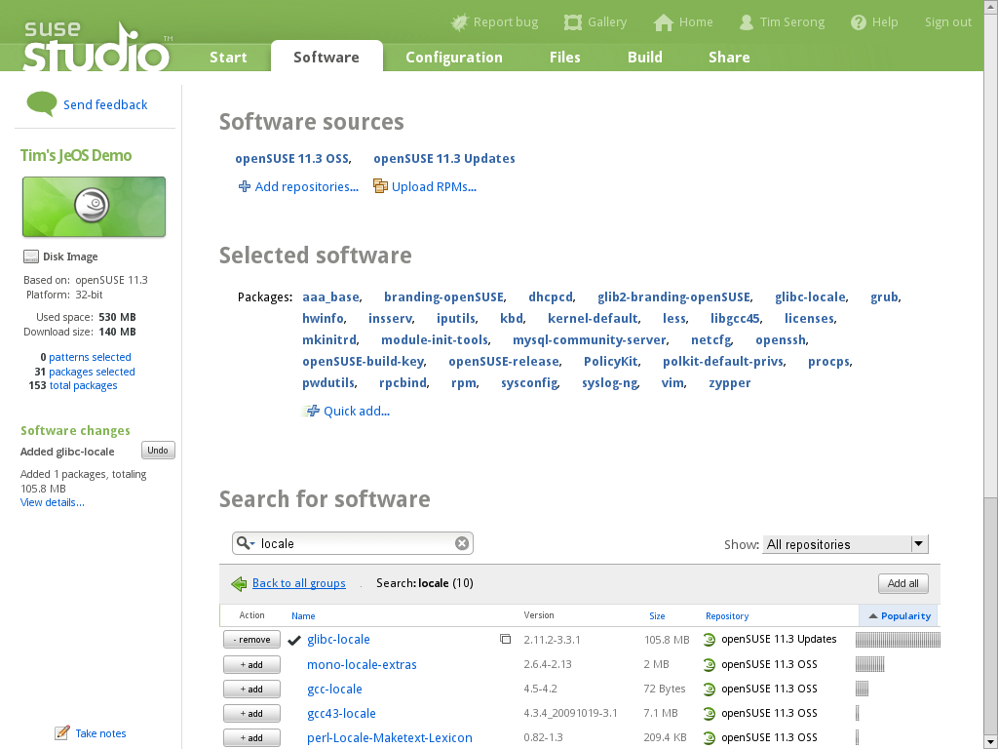
Notes:
Add “less”

Slide 42
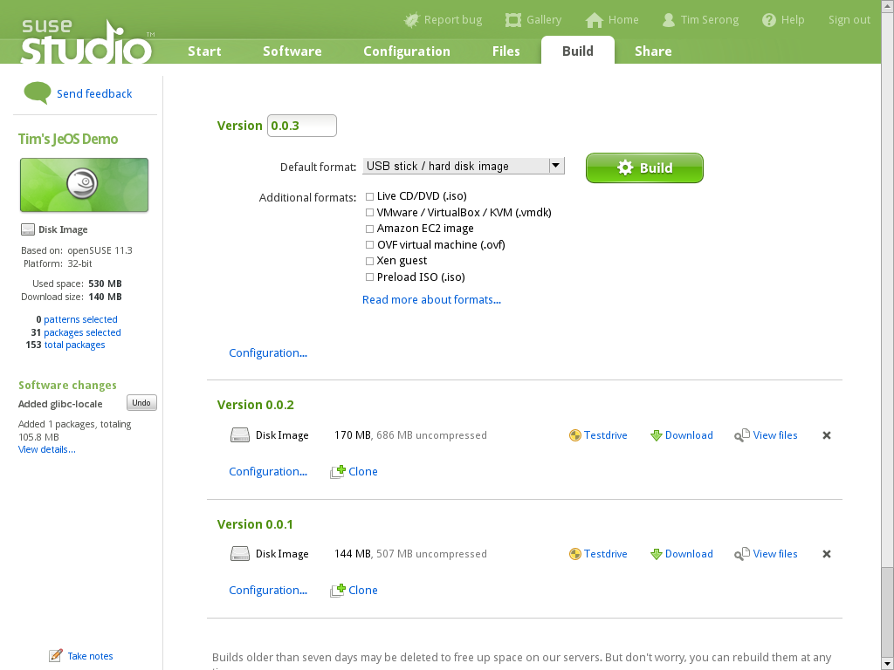
Notes:
Add “glibc-locale”

Slide 43
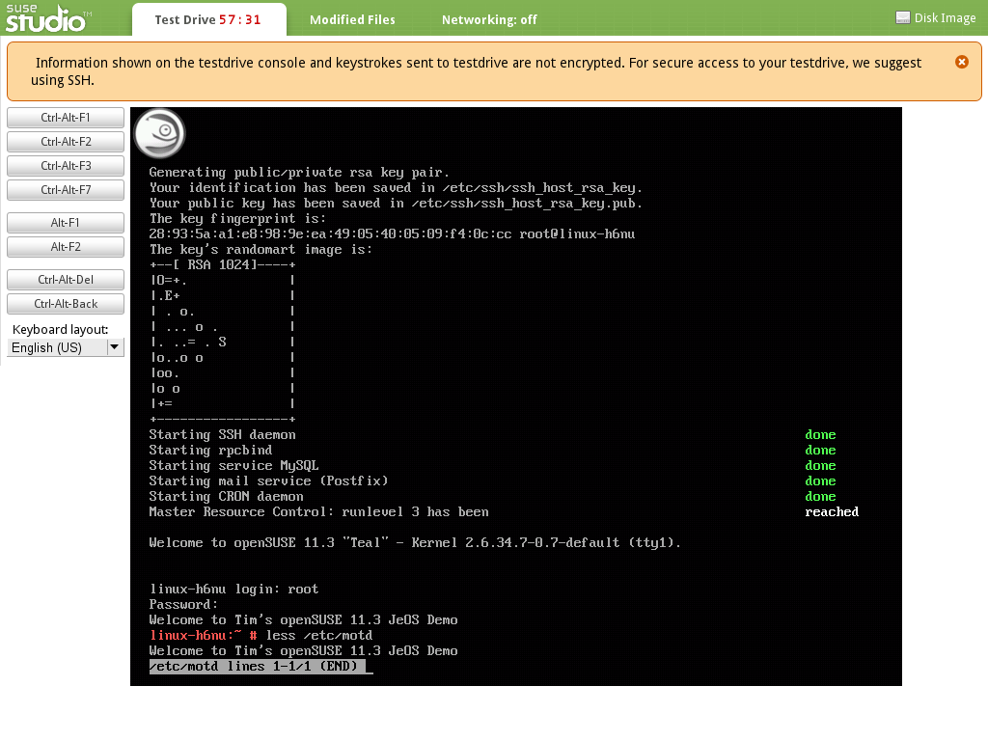
Notes:
File is there, no locale errors, less installed

Slide 44
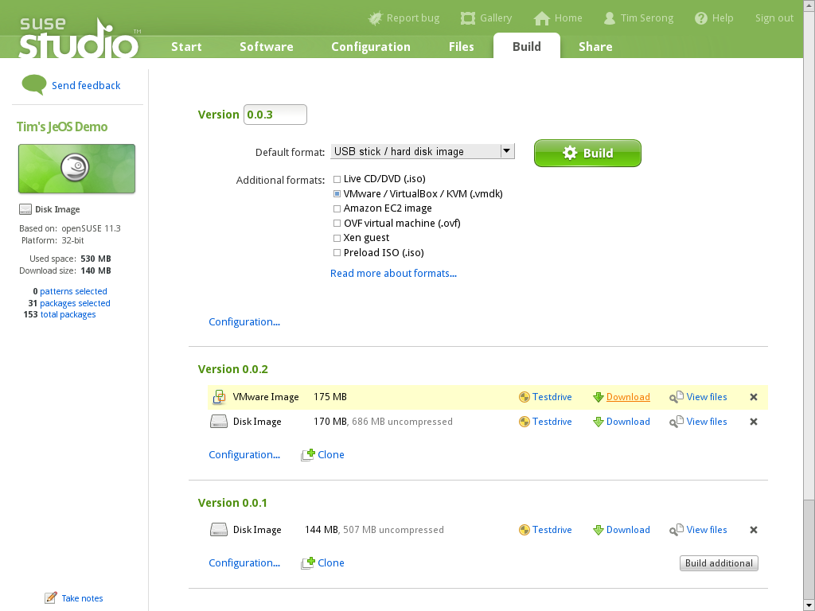
Notes:
Build and download VM

Slide 45
Let's Actually Deploy the VM Now...

Slide 46
A Quick Look at SUSE Gallery

Slide 47
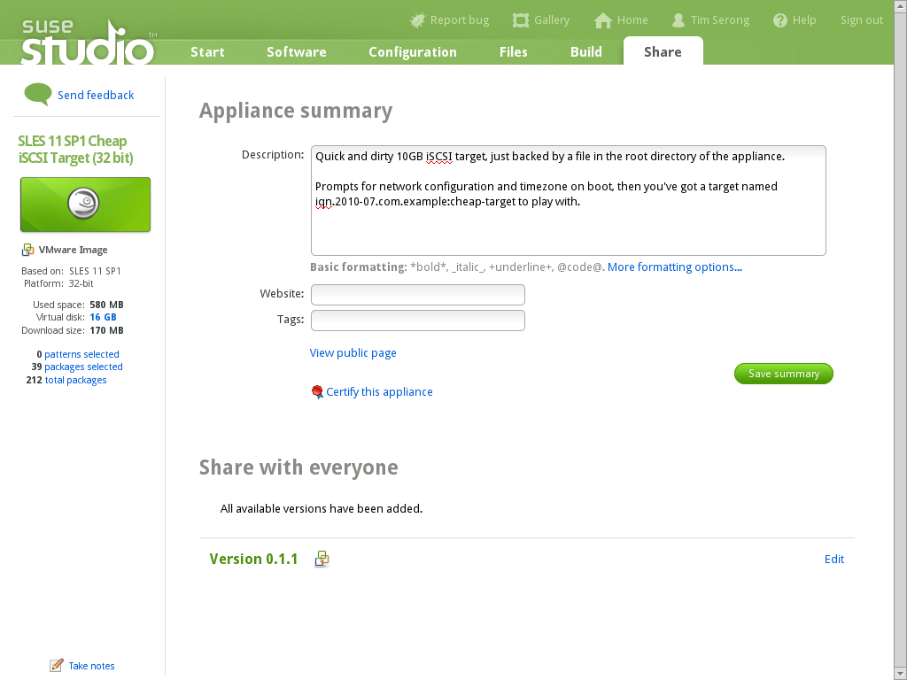
Notes:
One I made, here's what it looks like to share

Slide 48
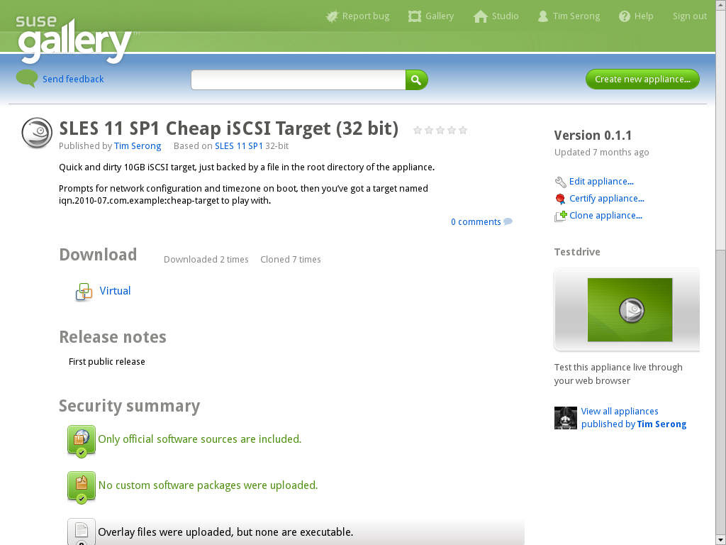
Notes:
Here's what everyone else sees
Note security info

Slide 49
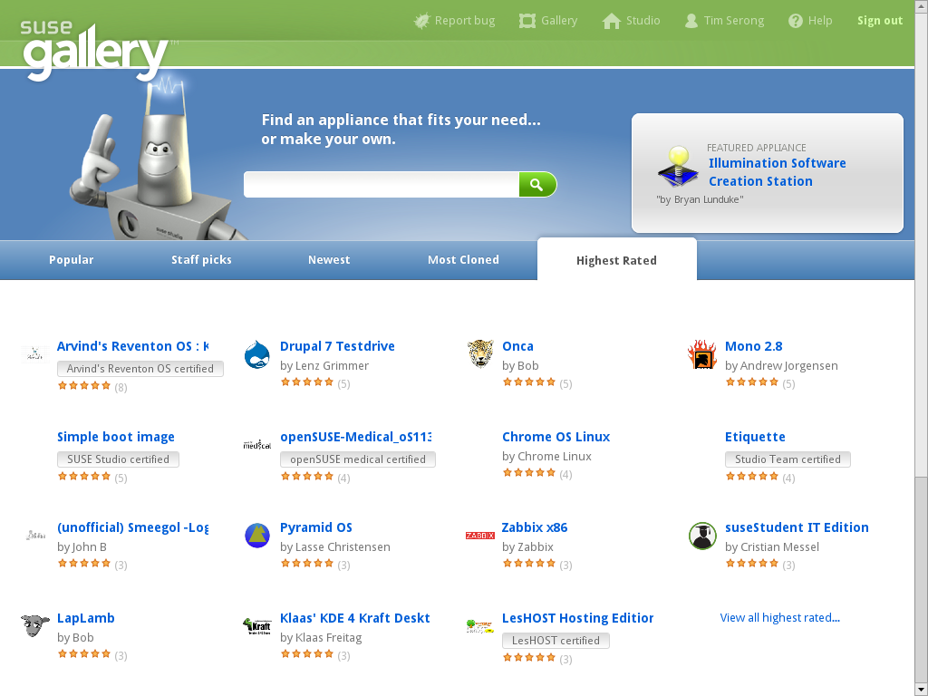
Notes:
Ratings, etc.

Slide 50
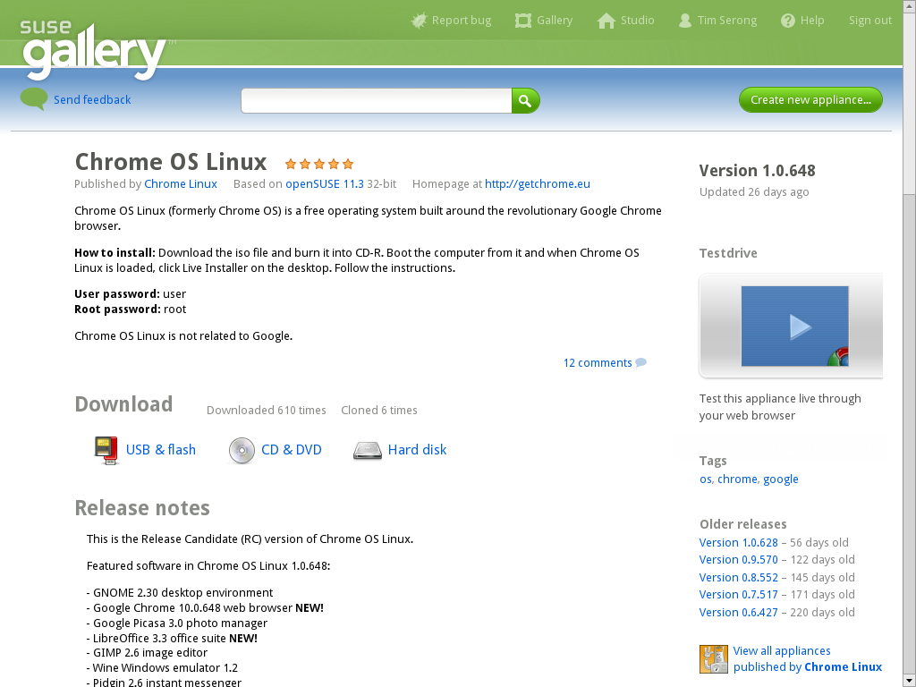
Notes:
e.g.: chrome OS (not the official one)

Slide 51
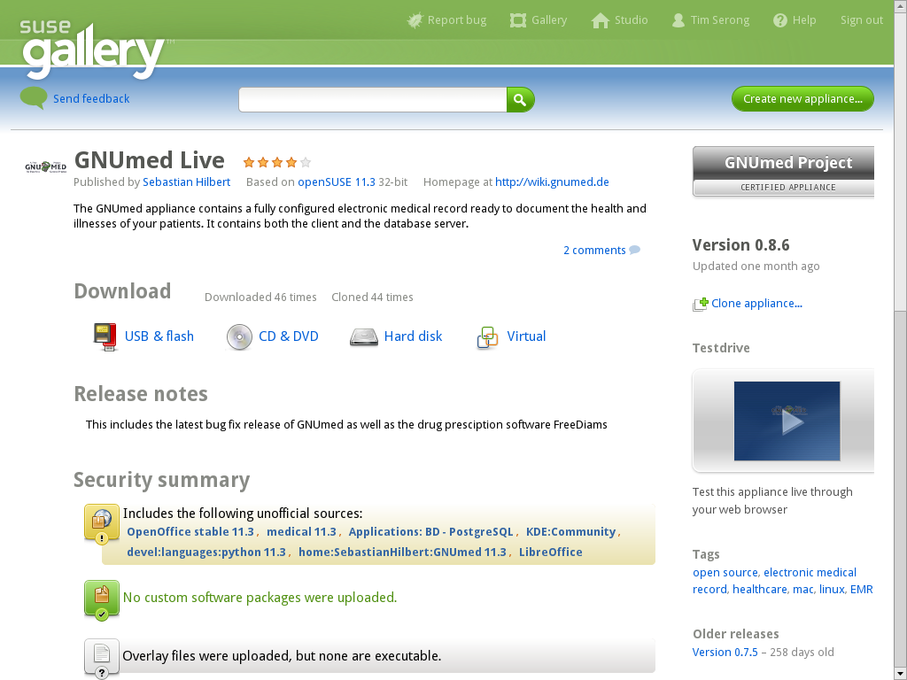

Slide 52
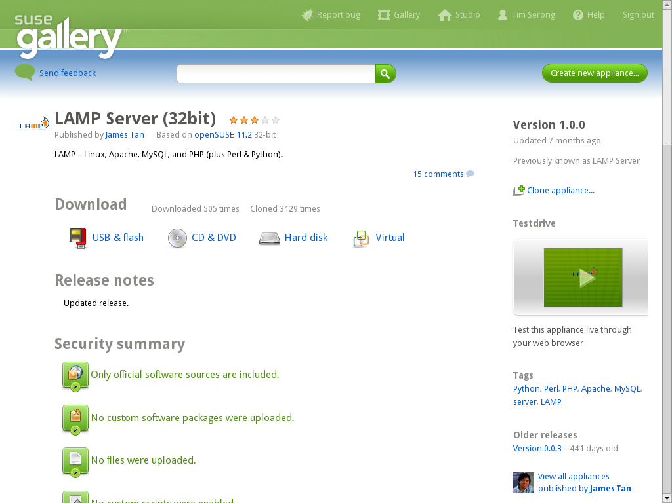

Slide 53
Any Questions?

